Slide 1
Smart Customer Support Chatbot
PROJECT DOMAIN: Natural Language Processing (NLP) + Generative AI
PROJECT TYPE: NLP + LLM + Web Application
CAPSTONE PROJECT
Presented By:
Student Name- Ruprekha Biswaas
College Name- The Heritage Academy
Department- BBA
4. AICTE ID- STU696647052e5541768310533

Slide 2
OUTLINE
Problem Statement
Proposed System/Solution
System Development Approach (Technology Used)
Algorithm & Deployment
Result
Conclusion
Future Scope
References

Slide 3
Problem Statement
Customer support systems often need to handle a large number of repetitive queries related to business hours, orders, delivery, returns, refunds, payments, and complaints. Responding to these queries manually can be time-consuming and may lead to delays in providing assistance. Customers also expect quick, clear, and understandable responses to their questions. Therefore, there is a need for an intelligent system that can understand natural-language customer queries and provide relevant, consistent, and context-aware assistance.

Slide 4
Proposed Solution
Smart Customer Support Chatbot
The proposed system provides an AI-powered customer-support interface where users can enter questions in natural language.
Main functions:
Accept user queries through a chat interface
Send queries to Gemini 3.6 Flash
Use conversation history for contextual responses
Generate natural-language answers
Handle invalid/empty inputs
Handle API and network errors
Maintain a simple and user-friendly interface
The chatbot represents the fictional company SmartMart.

Slide 5
System Approach
Technology Stack
Programming Language: Python
Frontend/Web Framework: Streamlit
LLM: Gemini 3.6 Flash
API: Google GenAI API
Conversation Memory: Streamlit session state
Configuration: Environment variables / Streamlit Secrets
Supporting Library: python-dotenv
Development Flow
User Query → Conversation History → Gemini API → Gemini 2.5 Flash → Generated Response → User

Slide 6
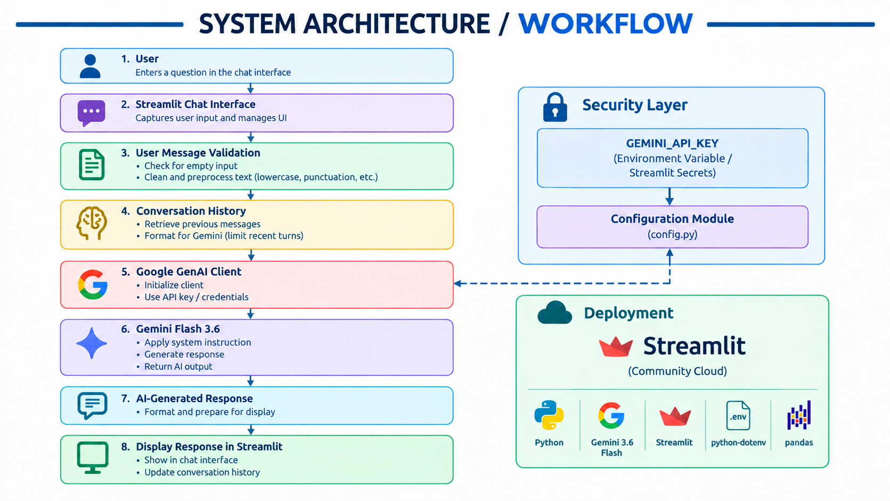
Algorithm & Deployment
DEPLOYMENT- Streamlit-based Web Application

Slide 7
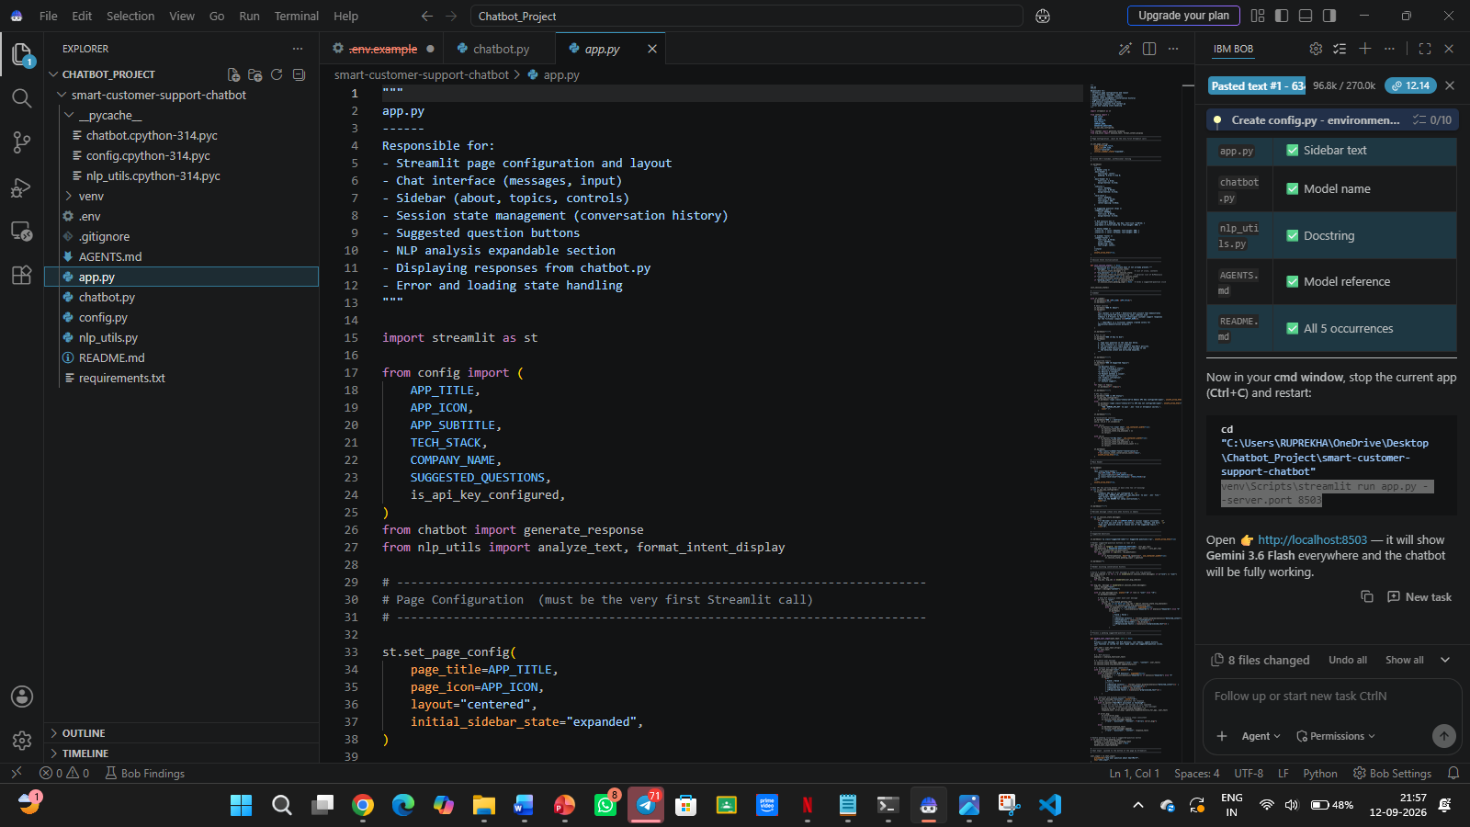
Result

Slide 8
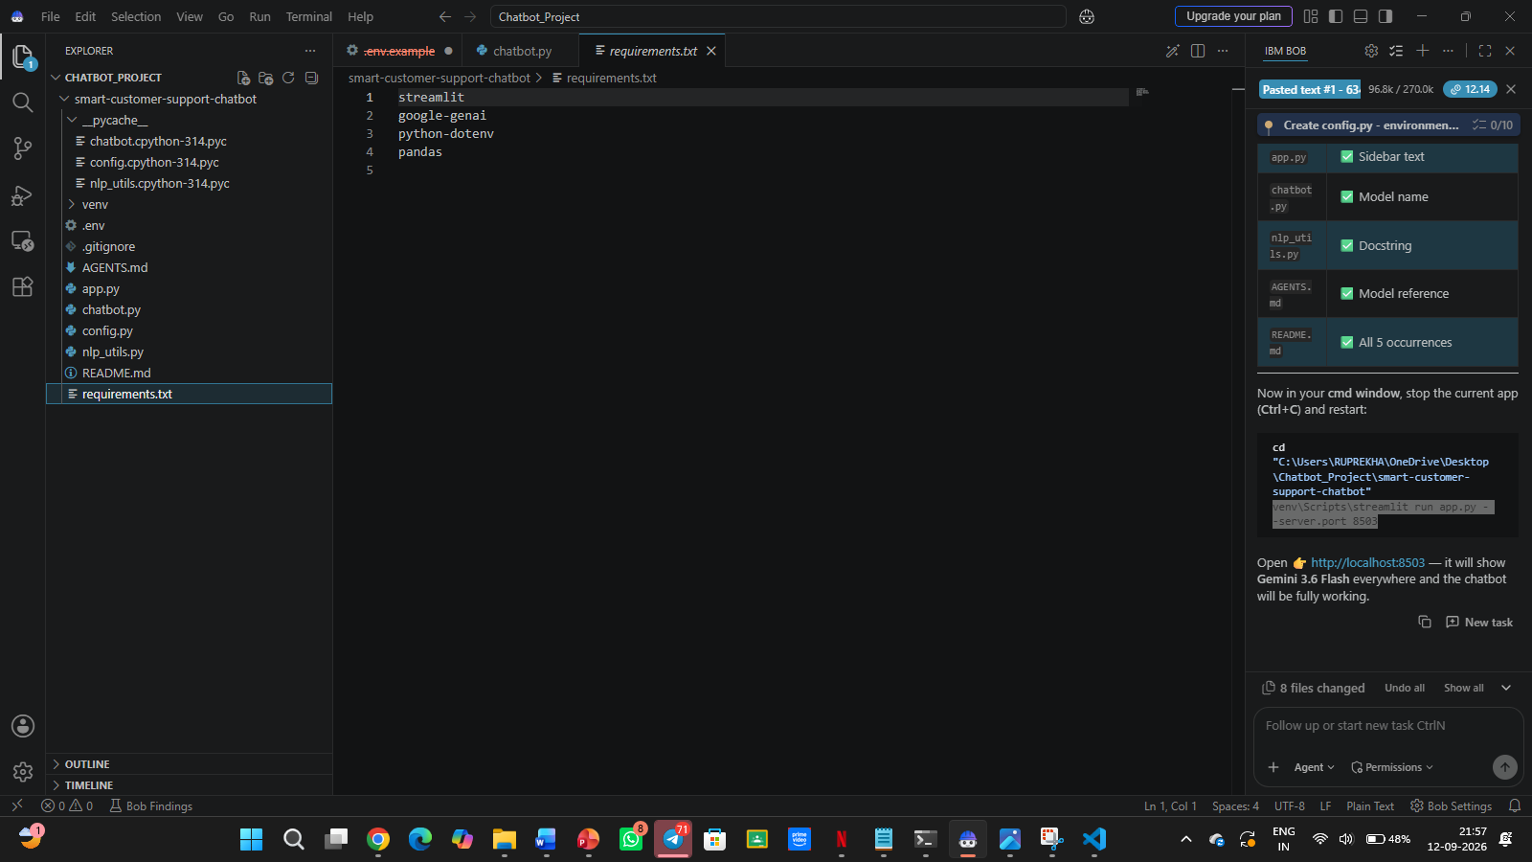
Result

Slide 9
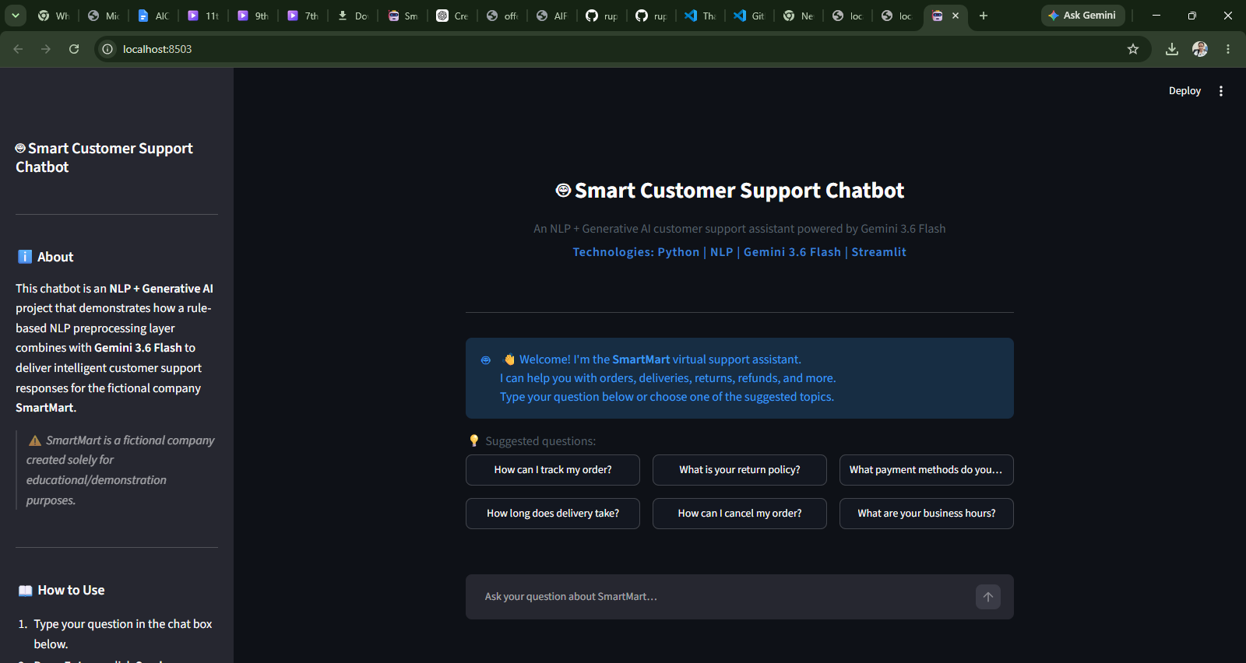
Result

Slide 10
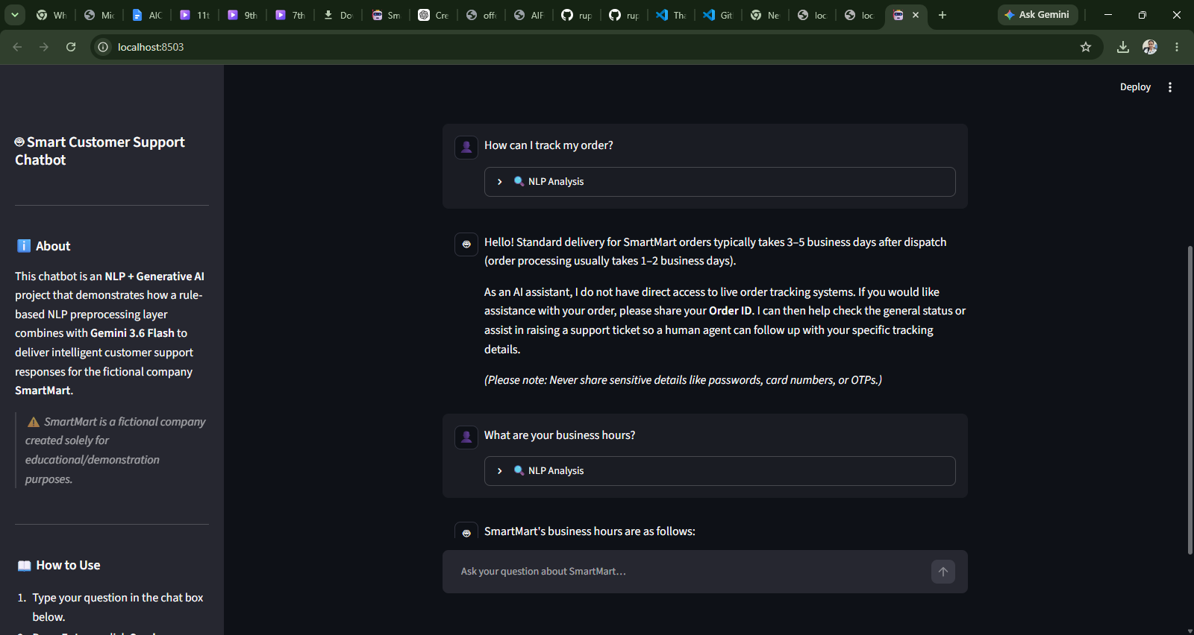
Result

Slide 11
Conclusion
The project successfully demonstrates the development of an AI-powered customer-support chatbot using:
Python
Streamlit
Google GenAI API
Gemini 3.6 Flash
Conversation history
Context-aware response generation
Error handling and API validation
The system provides an interactive platform for answering common SmartMart customer-support queries while demonstrating practical applications of NLP and Generative AI.

Slide 12
Future scope
Connect the chatbot to a real customer/order database
Add real-time order tracking
Implement advanced NLP-based intent classification
Add multilingual support
Add voice-based customer interaction
Introduce customer sentiment analysis
Add human-agent escalation
Store and analyze customer-support conversations
Personalize responses using authorized customer information

Slide 13
References
IBM BOB
Google Gemini / Google GenAI API
Gemini 3.6 Flash
Streamlit Documentation
Python Documentation
python-dotenv Documentation

Slide 14
Deployment link / github link
Github Link: https://github.com/ruprekhabiswas3-code/Smart-Customer-Support-Chatbot.git
Streamlit Link: http://localhost:8503/

Slide 15
THANK YOU

